Slide 1


Wicked Shorthand
Mark Kramer
Chief Engineer, Health Innovation Center
Chris Moesel
Principal Software Systems Engineer
MITRE Corporation
September, 2020

Slide 2
Post-STU 1 Planned Features
Disclaimer: Everything in this presentation is subject to change
Topics:
Soft Array Indexing
Parameterized Rule Sets
Context Paths
Logical Models

Slide 3
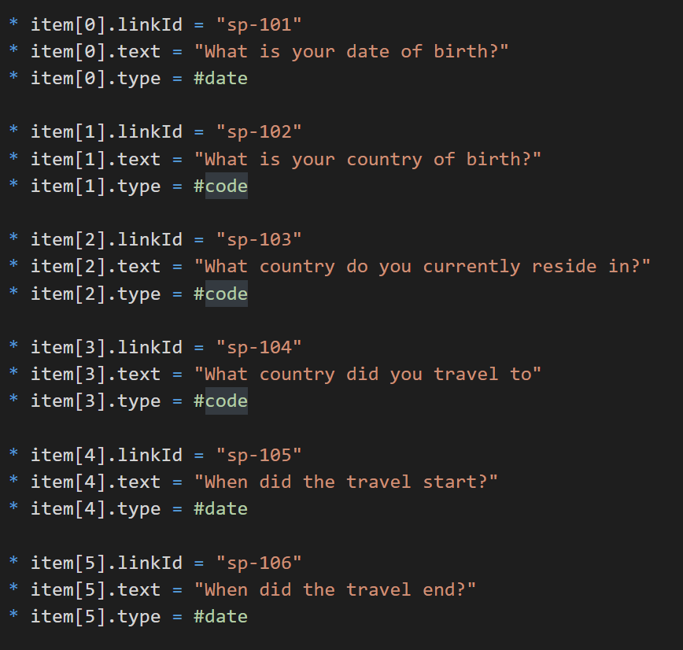
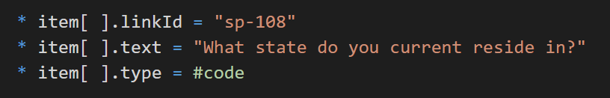
Soft Array Indexing
The problem is with long lists of array items that are explicitly numbered
Removing or adding elements means renumbering

Slide 4
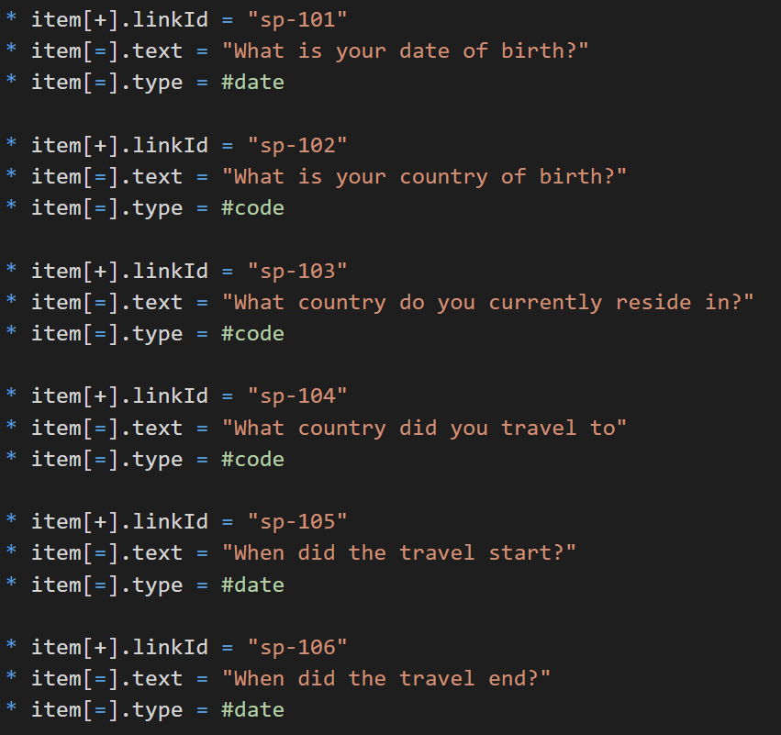
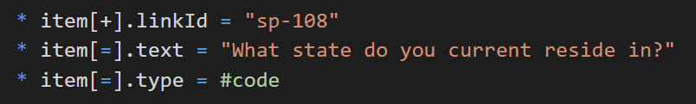
Soft Array Indexing
Approach:
[+] represents the next element in an array
If the array is empty, [+] represents the first element, [0]
[=] represents the same element of the array as the last time the array was referenced

Slide 5
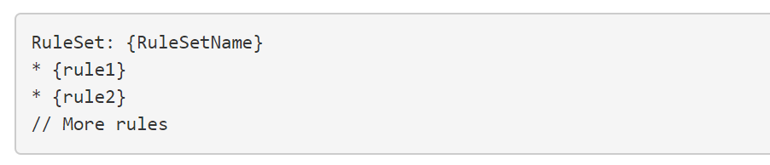
Rule Sets (Review)
Rule Sets provide the ability to define free-floating rules
The same rule set can be used in multiple places
Applied with an "insert" rule (formerly the Mixin keyword)
* insert {RuleSetName}

Slide 6
Parameterized Rule Set Proposal (aka "Macros")
RuleSet: XYZ(foo, bar)
* code = {foo}
* description = {bar}
Works by simple text substitution during a pre-processing step
Not like procedural function calls
No conditional logic
No actions
Parameters are treated as text strings
* insert XYZ (LNC#1234-5, "Hello, world")
preprocessor
* code = LNC#1234-5
* description = "Hello, world"

Slide 7
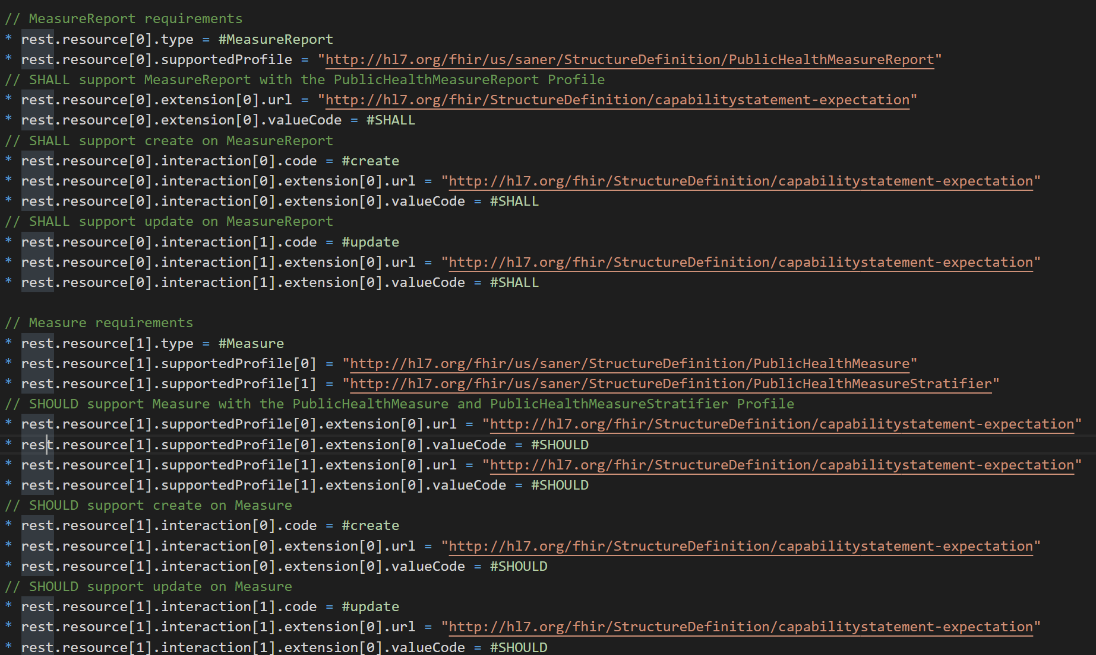
CapabilityStatement: Original FSH

Slide 8
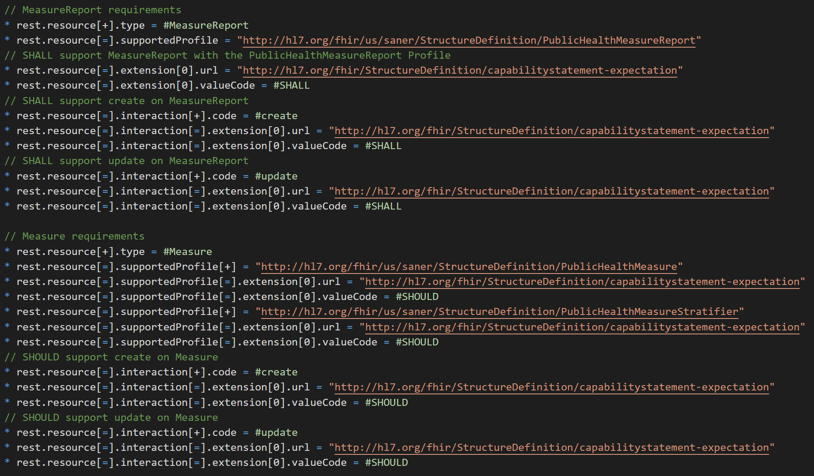
CapabilityStatement Example: Apply Soft Indexing

Slide 9

Convert Repeated Pattern to Parameterized Rule Set
structurally similar
generalize

Slide 10
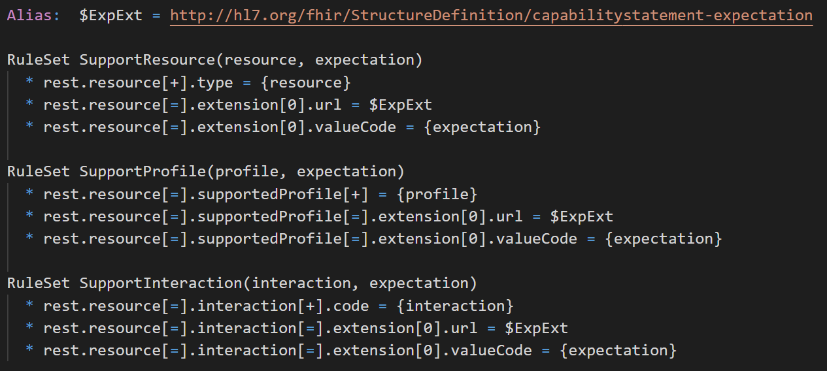
Capability Statement Rule Sets

Slide 11
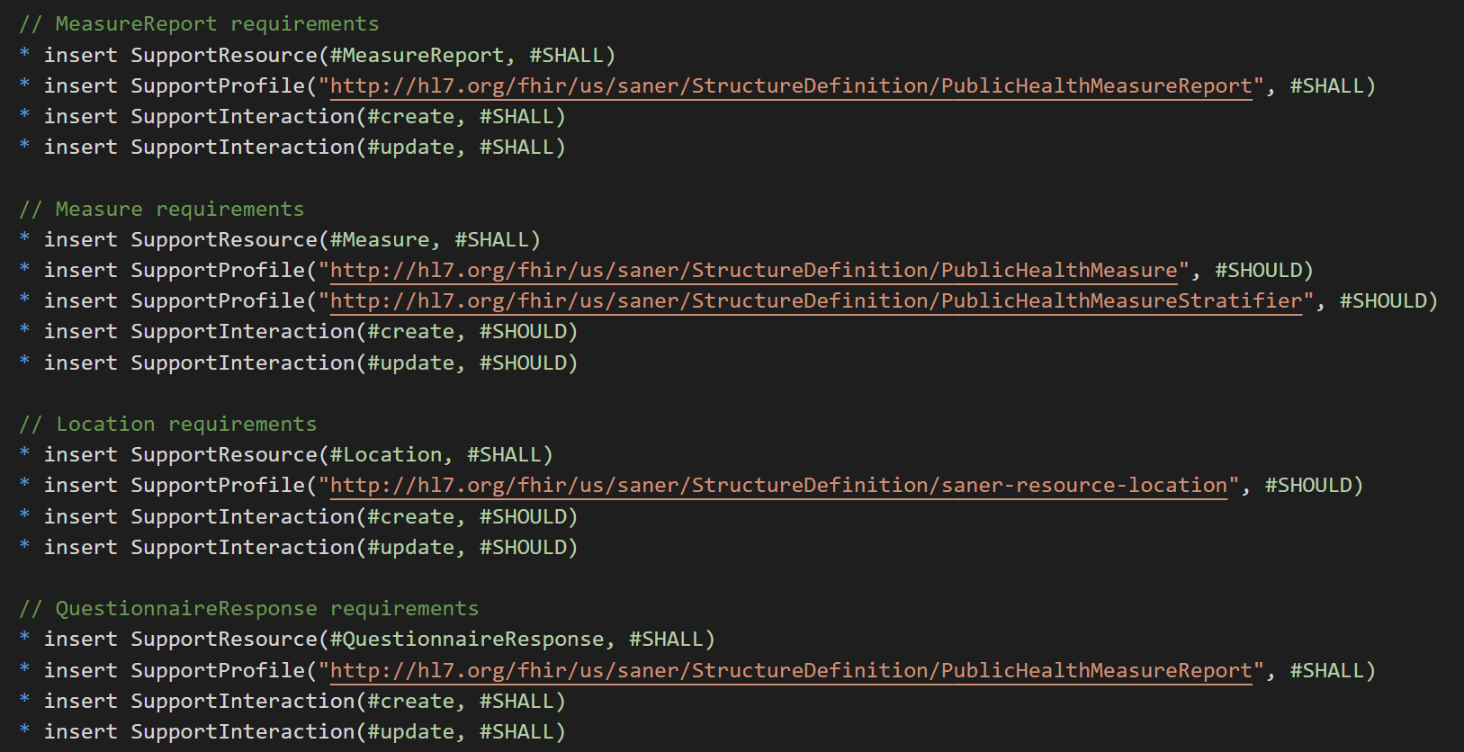
Capability Statement Example with Macros

Slide 12
Parameterized Rule Sets Summary
Facilitates more concise profiles
Almost like "custom rules" -- FSH doesn't have to introduce special new grammar for CapabilityStatements, OperationDefinition, Questionnaire, and other definitional resources
Makes it harder to figure out what's really happening
Rule sets can be shared -- naïve users can use macro library without knowing details

Slide 13
Context Paths
New shorthand for deeply indented /nested elements
* a.b.c.d = 1
* a.b.c.e = "string"
* a.b.c.f = #code
Written as:
* with a.b.c
** d = 1
** e = "string"
** f = #code
Thanks to Jose Costa Teixeira for this suggestion

Slide 14
Logical Models
Logical modeling can help formalize requirements gathered from stakeholders
Information is represented as a set of classes -- without the added complication of alignment with FHIR.
Activity Diagrams
Transactions
FHIR Operations
Use Cases
FHIR Capability Statement
Data Elements
Logical Models
FHIR Profiles

Slide 15
FHIR Logical Models
The only thing that makes logical models "FHIR Logical Models" is the use of the StructureDefinition as a formal representation.
A FHIR logical model resembles a new FHIR resource, including attributes, cardinality, datatype, and terminology bindings.
Specified in StructureDefinition.kind = #logical
The following is speculative

Slide 16
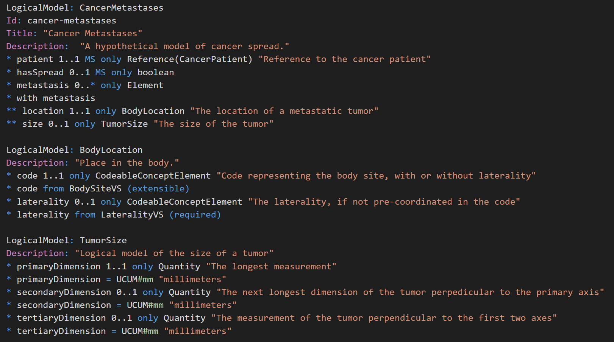
Potential Logical Model Shorthand

Slide 17


In Summary...
STU 2 -- Aiming for May 2021 ballot cycle
FSH STU
FSH STU, TOO

